Slide 1
ST1G Capstone Project
Cancer data – Kaggle
Zeguo li
u3175010

Slide 2
The dataset-What can it be used for?
Cancer data – Kaggle -> 569 (cancer) cells’ geometric data from image
Diagnosis : Malignant(M) or Benign(B)
30 features, including radius, texture, area, concavity, and their mean, SE, worst/largest mean value etc.)
Dataset -> Train machine learning model -> Predict tumour cell (B or M)
Increase patient’s chance of survival if accurate on positive case
Or, prevent the patient from undergoing unnecessary treatment

Slide 3
Planned Methodology
Steps of implementation:
1. Load the dataset and perform Exploratory data analysis
2. Data pre-processing: remove unnecessary entries, feature scaling.
3. Data splitting -> e.g., train-test split, or K-fold cross validation (different split)
4. Model selection: Best performing candidates from k-fold cross validation
5. Hyper parameter tuning -> GridSearchCV
6. Train the selected model and Performance evaluation
7. Streamlit web application

Slide 4
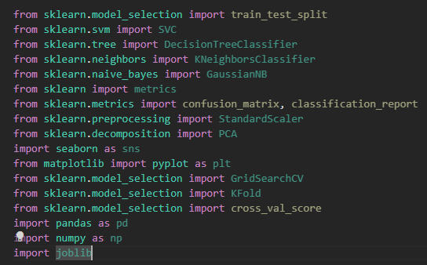

Libraries and packages used

Slide 5

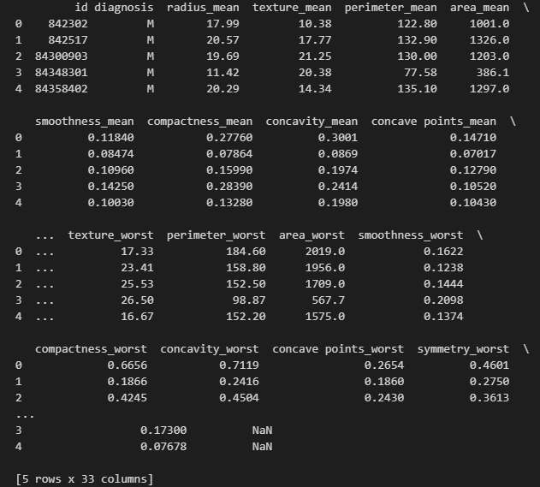
Exploratory Data Analysis

Slide 6
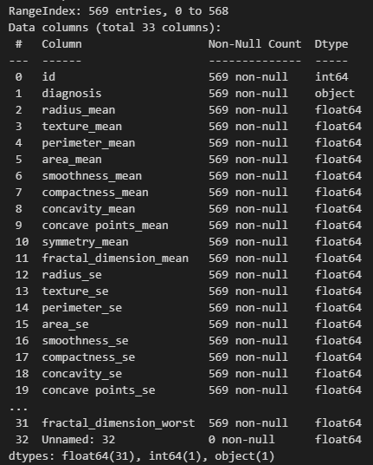
Exploratory Data Analysis

Slide 7

EDA – distribution of features and targets

Slide 8
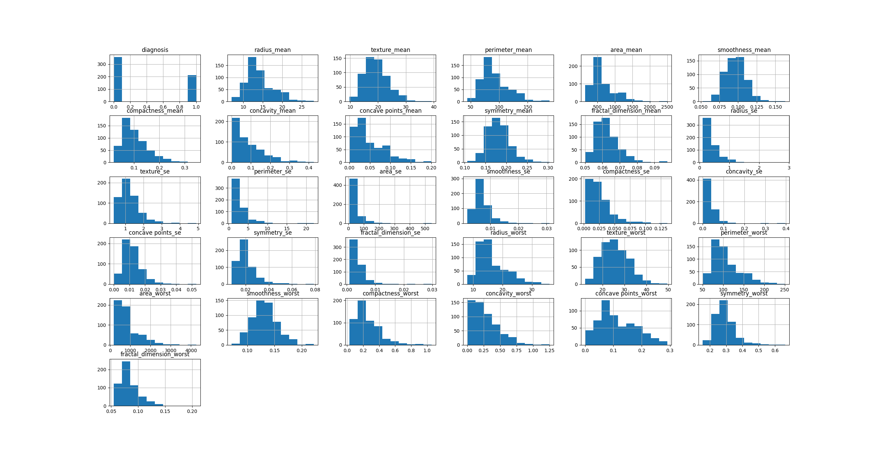

Slide 9
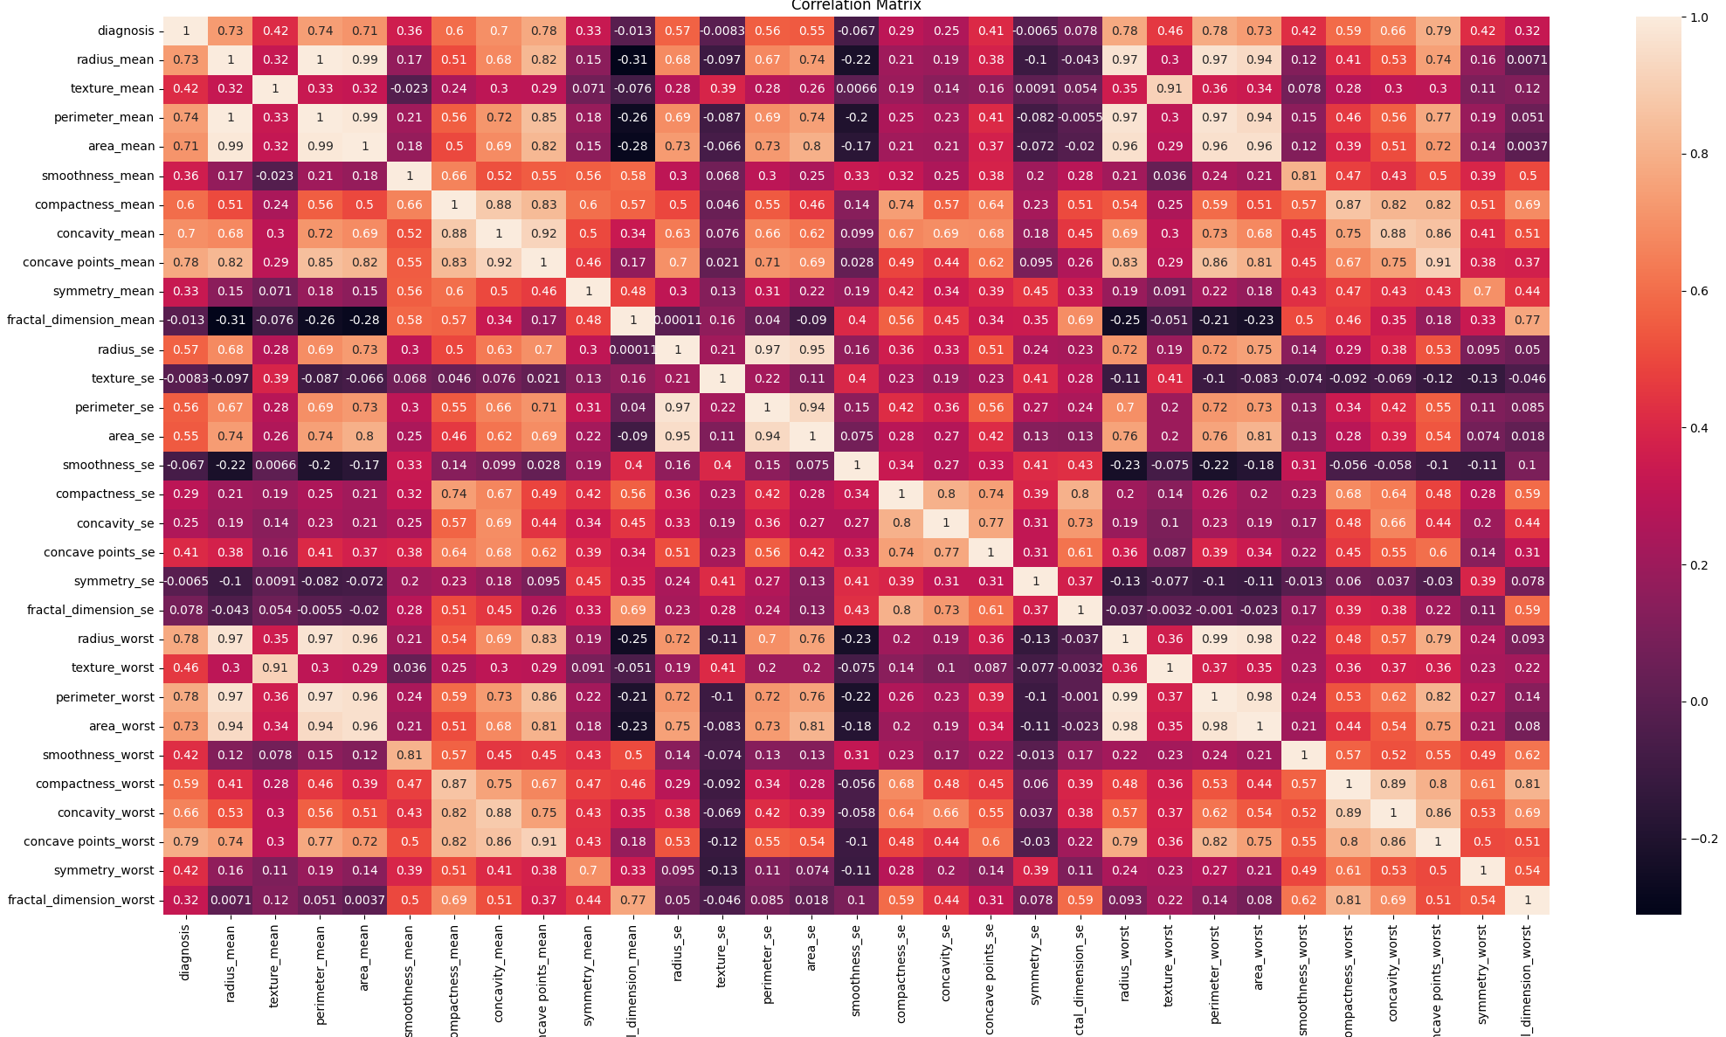
EDA – correlation matrix

Slide 10
Data pre-processing and test run
Feature scaling -> Standardscaler(), lower the magnitude, difference in unit.
Remove unnecessary data -> ID, unnamed
Train-test-split to test the effect of the above measures.
K-fold cross validation -> DT, KNN, NB, and SVM. Avoid overfitting.

Slide 11
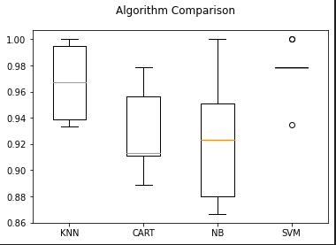

Choose ML model
Support Vector Machine!

Slide 12


Hyper parameter tuning

Slide 13
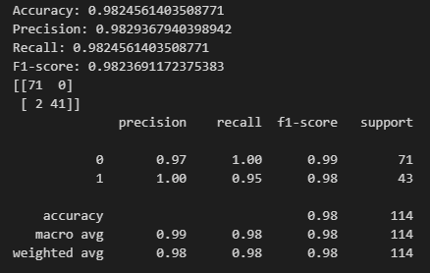
Model training result

Slide 14
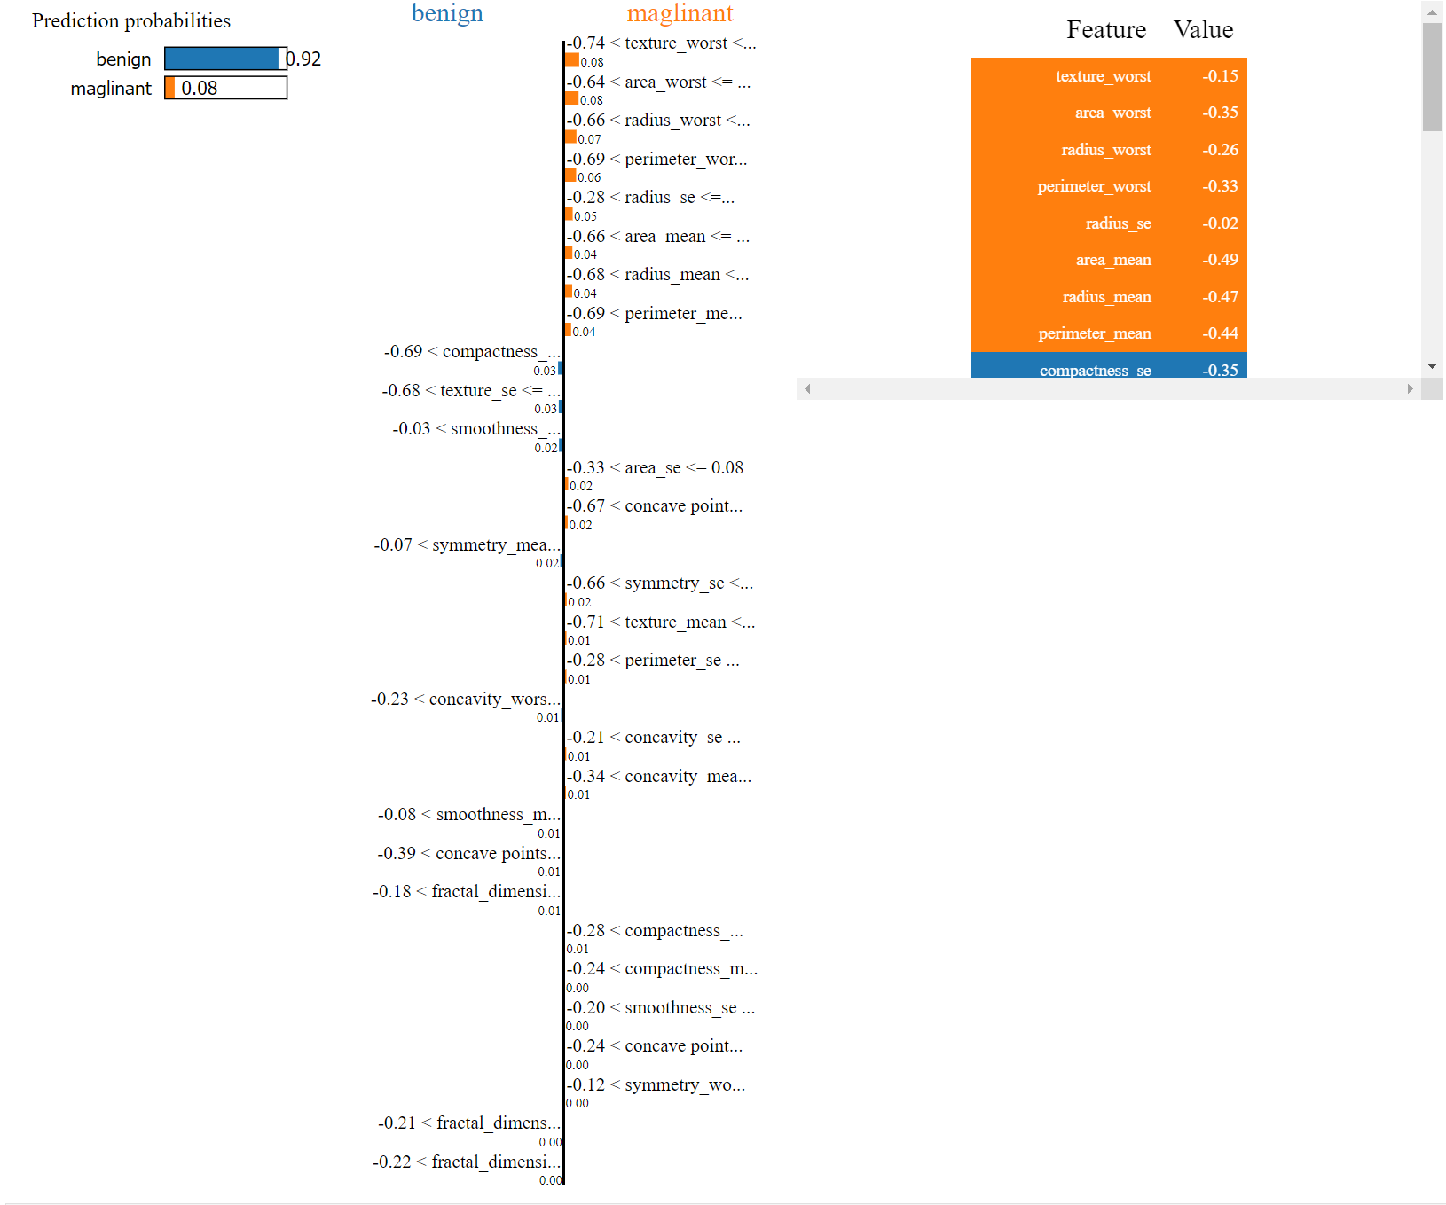
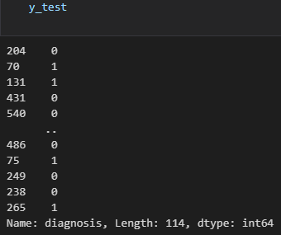
Lime package Model interpretation

Slide 15
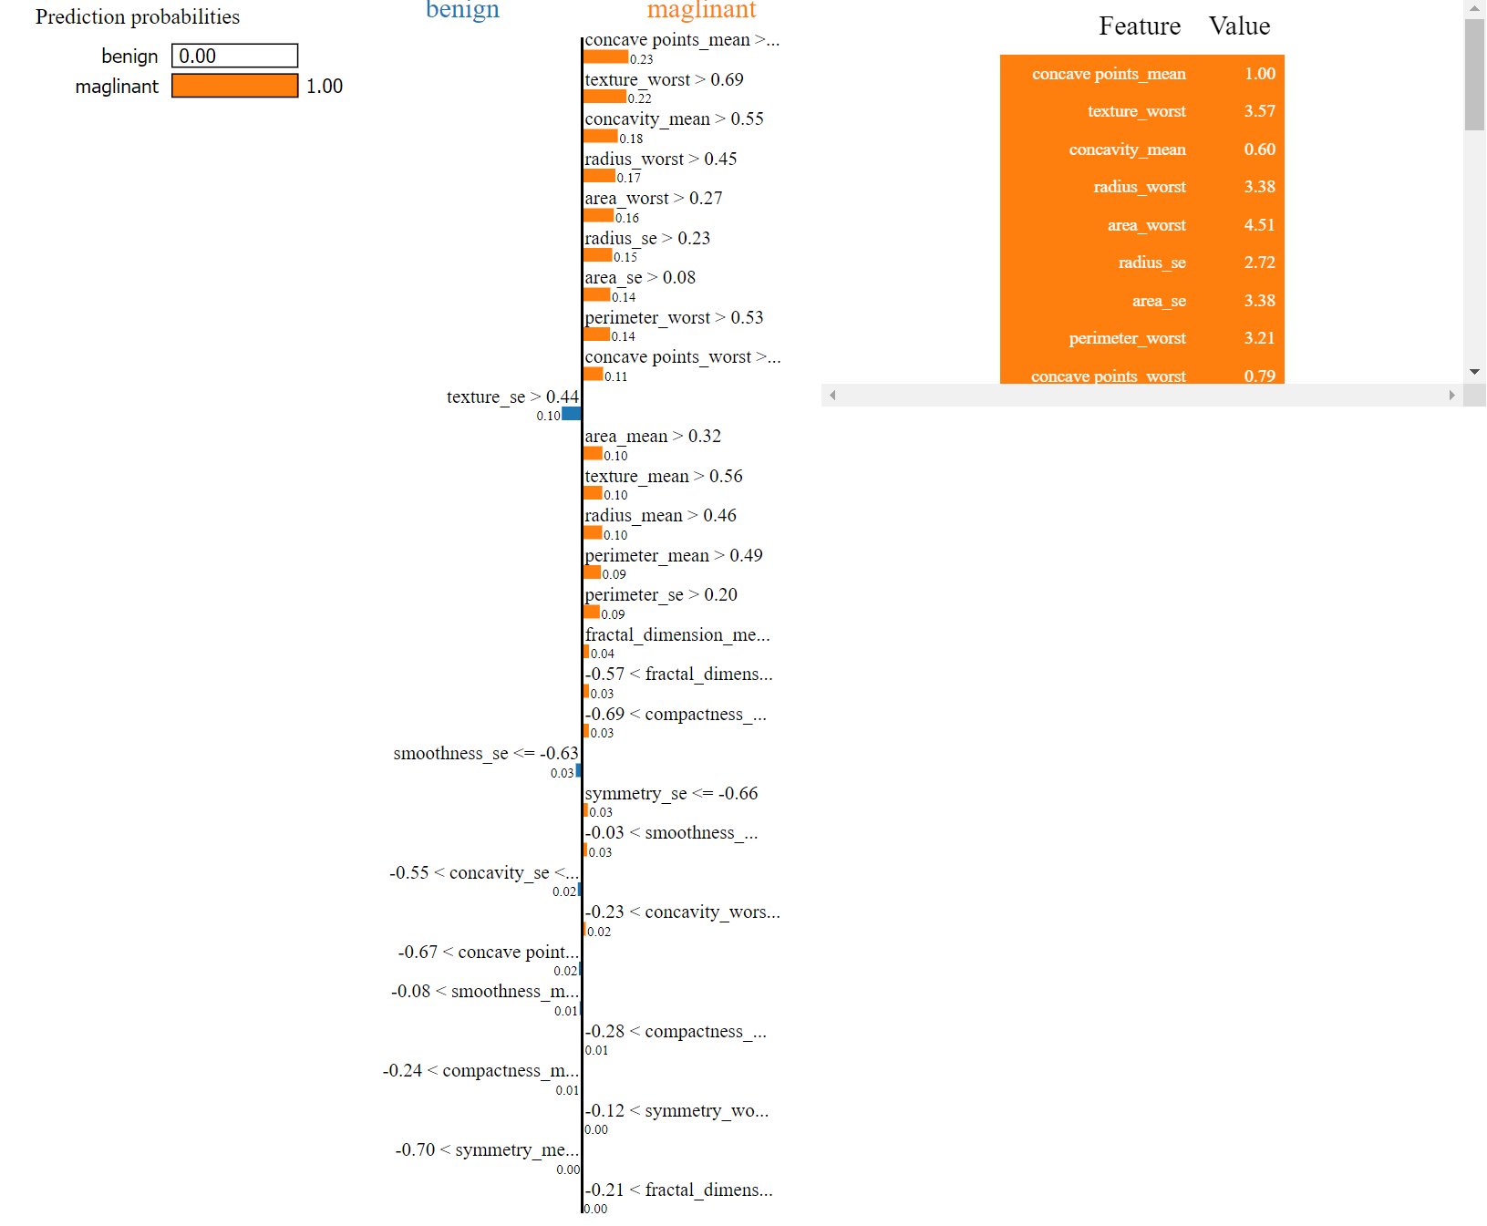
Lime package Model interpretation

Slide 16
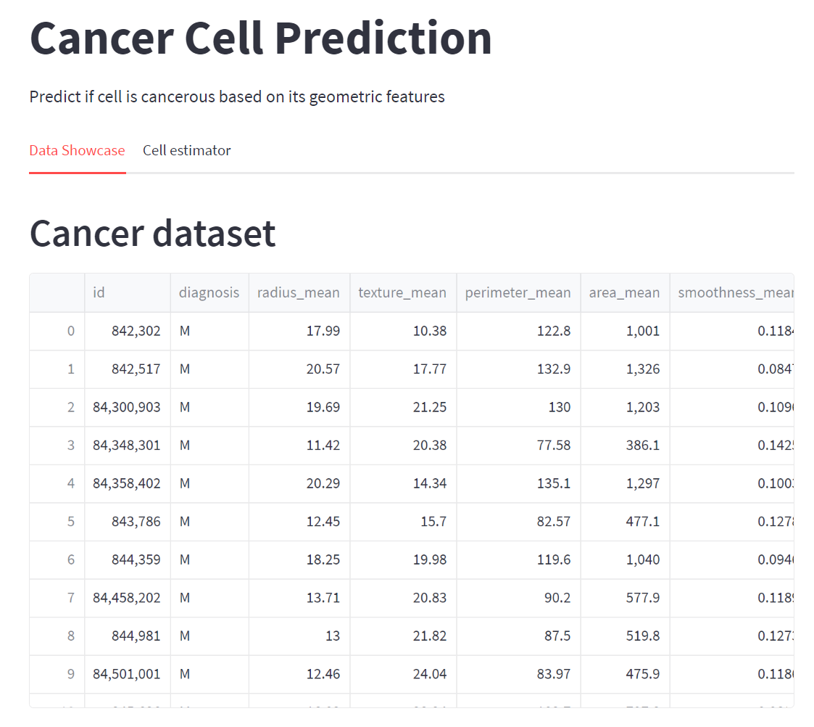
Web Application

